Slide 1
My Autobiography Nicholas Mutisya C025-01-0941/2021

Slide 2
Introduction
Hello, my name is Nicholas Mutisya. Today, I'll share my journey from Mithumo village to the Dedan Kimathi University of Technology, detailing my educational path, professional experiences, and personal insights.

Slide 3
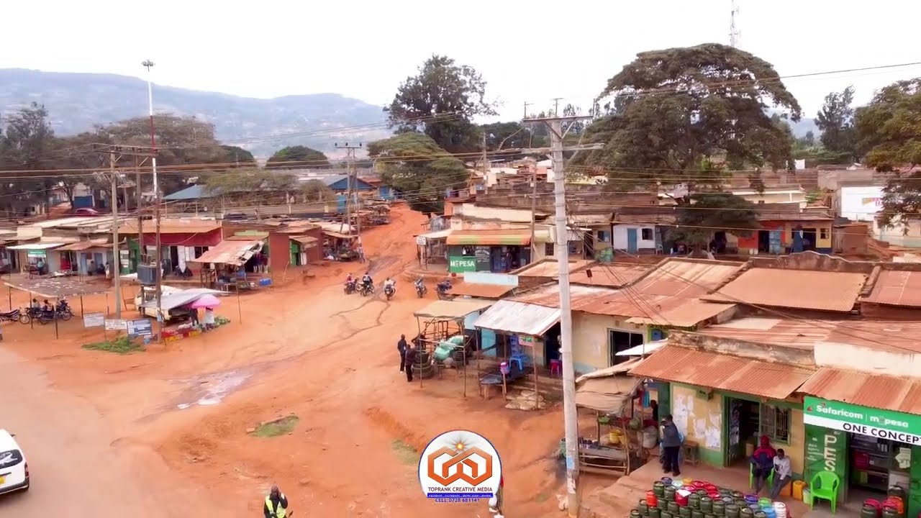
Early Life
I was born and raised in Mithumo village, located in Mbooni, Makueni County. My parents, Agnes and Joseph, raised me alongside my two sisters, Joy and Eva, and two brothers, Dominic and Jack. Growing up in a vibrant community, I learned the values of cooperation and resilience from a very young age.

Slide 4
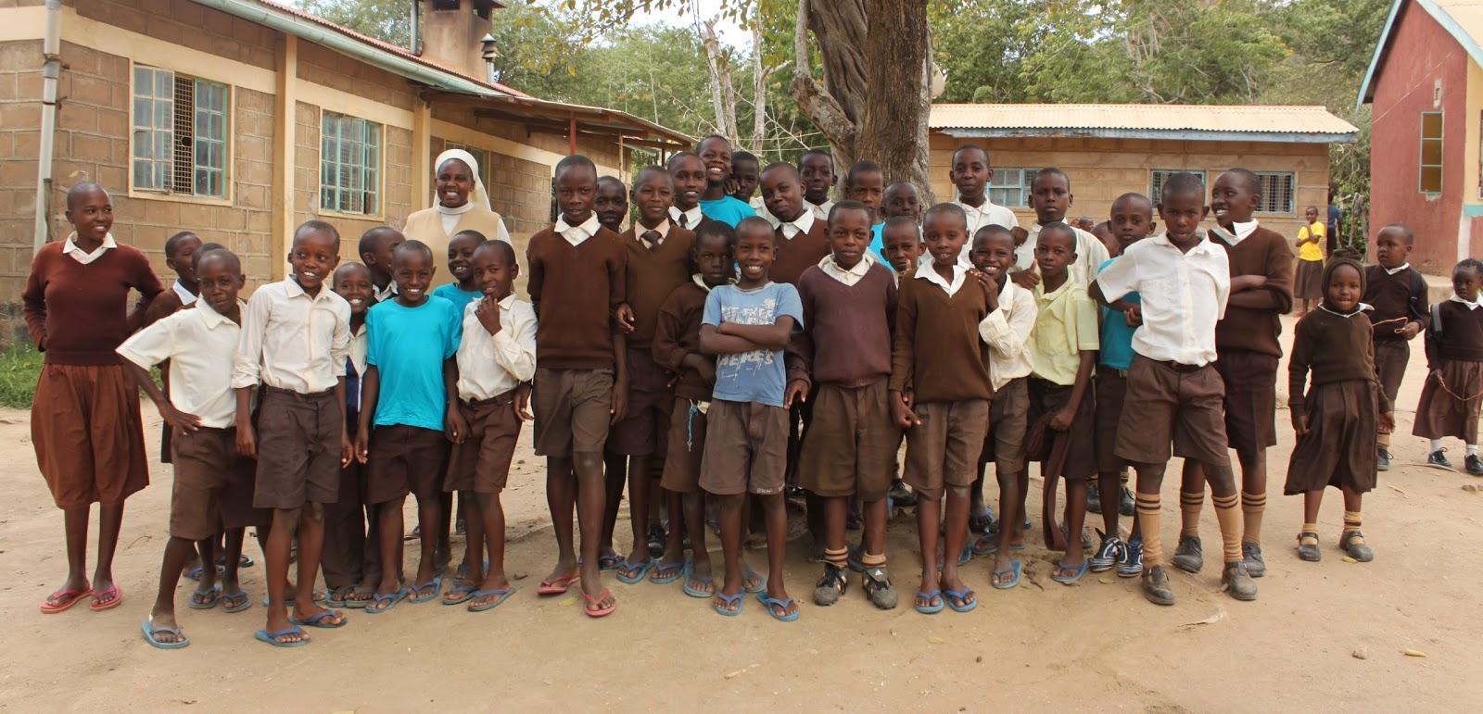
Primary Education
My educational journey began at Mithumo Primary School, where I studied from 2008 to 2016. During this period, I was actively involved in various school activities, which helped lay a strong foundation in teamwork and leadership. My interest in sciences was nurtured alongside a growing passion for creative arts.

Slide 5
Secondary Education
I continued my education at The Kitondo School from 2017 to 2020. Excelling in the Kenya Certificate of Secondary Education, I earned a scholarship that highlighted my academic dedication. I participated in debates and science clubs, which sharpened my public speaking skills and fostered a keen analytical mindset.

Slide 6
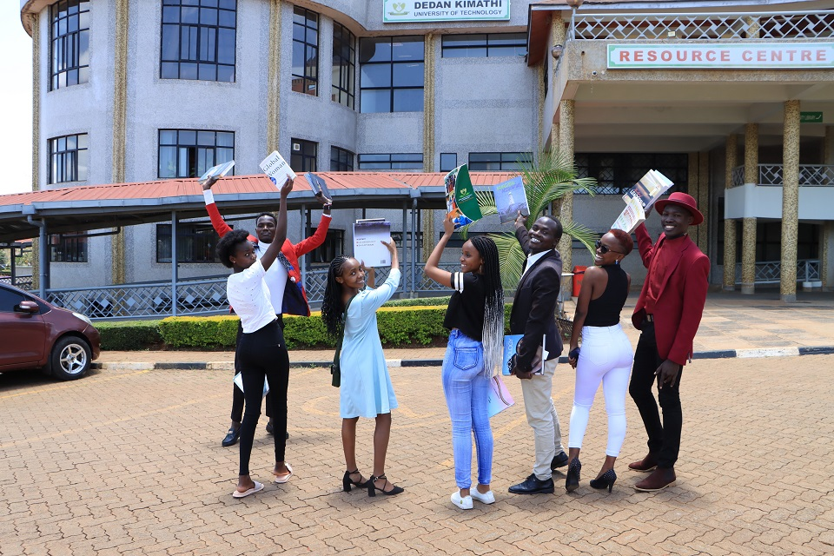
University Education
I am currently pursuing a Bachelor of Science in Information Technology at Dedan Kimathi University of Technology, with an expected graduation year of 2024. My studies focus on software development and cybersecurity, preparing me for a future where I can contribute to digital innovation and safeguarding digital assets.

Slide 7

Professional Experience
In January 2024, I began an internship with Eneza Education as a Content Intern. This role involves uploading educational content to platforms, ensuring alignment with educational standards, and collaborating on projects aimed at enhancing digital learning. My experience here has been instrumental in applying theoretical knowledge in practical settings.

Slide 8
Leadership Experience
During my time at The Kitondo School, I served as a student leader, where I led a team of student representatives in organizing school events, fundraisers, and community service activities. This role not only enhanced my leadership skills but also deepened my commitment to community service

Slide 9
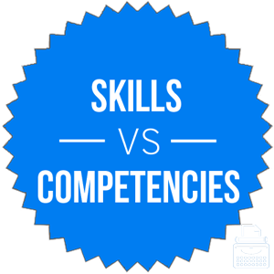
Skills and Competencies
Throughout my academic and professional journey, I have developed a robust set of skills including advanced proficiency in web development using HTML, CSS, JavaScript, and Android app development using Java and XML. My strong communication skills complement my technical abilities, enabling me to work effectively in diverse teams.

Slide 10
Future Aspirations
Looking ahead, I aim to leverage my skills and experiences to make a significant impact in the field of Information Technology. I am particularly interested in innovations that improve cybersecurity measures and software solutions that enhance user experiences.

Slide 11
Conclusion
Thank you for allowing me to share my story. My journey has been shaped by a blend of cultural heritage, educational achievements, and a strong drive to succeed professionally and personally.

